Slide 1
Lab: file system
2022.12.06

Slide 2
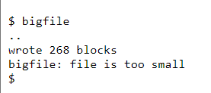
Large files
In this assignment you'll increase the maximum size of an xv6 file. Currently xv6 files are limited to 268 blocks, or 268*BSIZE bytes (BSIZE is 1024 in xv6). This limit comes from the fact that an xv6 inode contains 12 "direct" block numbers and one "singly-indirect" block number, which refers to a block that holds up to 256 more block numbers, for a total of 12+256=268 blocks.
Read “Chapter 8: File system” from the xv6 book.
git clone git://g.csail.mit.edu/xv6-labs-2022
git fetch
git checkout fs
make clean

Slide 3
Large files
data
dinode
Blocks: 12+256=268
type
major
minor
nlink
size
addrs 1
……
addrs 12
indirect
……
data
data
indirect block
……
addrs 1
……
addrs 256
data

Slide 4
Large files
You'll change the xv6 file system code to support a "doubly-indirect" block in each inode, containing 256 addresses of singly-indirect blocks, each of which can contain up to 256 addresses of data blocks. The result will be that a file will be able to consist of up to 65803 blocks, or 256*256+256+11 blocks (11 instead of 12, because we will sacrifice one of the direct block numbers for the double-indirect block).

Slide 5
Large files
Blocks: 11+256+256*256=65803
dinode
data
type
major
minor
nlink
size
addrs 1
……
addrs 11
indirect
doubly-indirect
……
data
data
……
indirect block
data
addrs 1
……
addrs 256
indirect block
addrs 1
……
addrs 256
data
……
doubly-indirect block
data
addrs 1
……
addrs 256
…
……
addrs 1
……
addrs 256
data
……
data

Slide 6
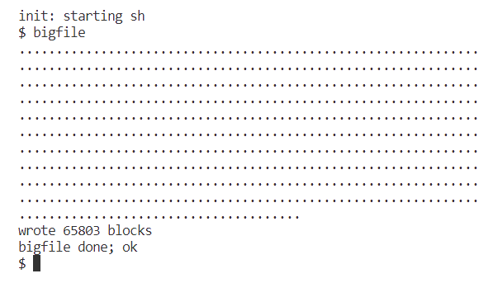
Large files
The format of an on-disk inode is defined by struct dinode in kernel/fs.h..
The format of an in-memory inode copy is defined by inode in kernel/file.h.
You're particularly interested in NDIRECT, NINDIRECT, MAXFILE, and the addrs[] element of struct dinode.
Modify kernel/fs.c bmap() so that it implements a doubly-indirect block, in addition to direct blocks and a singly-indirect block.
Make sure kernel/fs.c itrunc() frees all blocks of a file, including double-indirect blocks.
The code that finds a file's data on disk is in bmap() in fs.c. Have a look at it and make sure you understand what it's doing. bmap() is called both when reading and writing a file. When writing, bmap() allocates new blocks as needed to hold file content, as well as allocating an indirect block if needed to hold block addresses.
bmap() deals with two kinds of block numbers. The bn argument is a "logical block number" -- a block number within the file, relative to the start of the file. The block numbers in ip->addrs[], and the argument to bread(), are disk block numbers. You can view bmap() as mapping a file's logical block numbers into disk block numbers.

Slide 7
Large files
Hints:
Make sure you understand bmap().
If you change the definition of NDIRECT, you'll probably have to change the declaration of addrs[] in struct inode in file.h. Make sure that struct inode and struct dinode have the same number of elements in their addrs[] arrays.
If you change the definition of NDIRECT, make sure to create a new fs.img, since mkfs uses NDIRECT to build the file system.
If your file system gets into a bad state, perhaps by crashing, delete fs.img (do this from Unix, not xv6). make will build a new clean file system image for you.
Don't forget to brelse() each block that you bread().
You should allocate indirect blocks and doubly-indirect blocks only as needed, like the original bmap().
Make sure itrunc frees all blocks of a file, including double-indirect blocks.

Slide 8
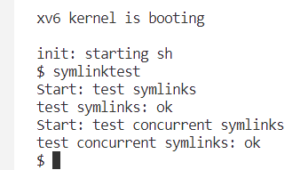
Symbolic links
In this exercise you will add symbolic links to xv6. Symbolic links (or soft links) refer to a linked file by pathname; when a symbolic link is opened, the kernel follows the link to the referred file.
You will implement the symlink(char *target, char *path) system call, which creates a new symbolic link at path that refers to file named by target. To test, add symlinktest to the Makefile and run it.

Slide 9
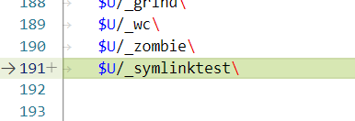
Symbolic links
Hints 1:
First, create a new system call number for symlink, add an entry to user/usys.pl, user/user.h, and implement an empty sys_symlink in kernel/sysfile.c.
Add a new file type (T_SYMLINK) to kernel/stat.h to represent a symbolic link.
Add a new flag to kernel/fcntl.h, (O_NOFOLLOW), that can be used with the open system call. Note that flags passed to open are combined using a bitwise OR operator, so your new flag should not overlap with any existing flags. This will let you compile user/symlinktest.c once you add it to the Makefile.

Slide 10
Symbolic links
Hints 2:
Implement the symlink(target, path) system call to create a new symbolic link at path that refers to target. Note that target does not need to exist for the system call to succeed. You will need to choose somewhere to store the target path of a symbolic link, for example, in the inode's data blocks. symlink should return an integer representing success (0) or failure (-1) similar to link and unlink.
Modify the open system call to handle the case where the path refers to a symbolic link. If the file does not exist, open must fail. When a process specifies O_NOFOLLOW in the flags to open, open should open the symlink (and not follow the symbolic link).

Slide 11
Symbolic links
Hints 3:
If the linked file is also a symbolic link, you must recursively follow it until a non-link file is reached. If the links form a cycle, you must return an error code. You may approximate this by returning an error code if the depth of links reaches some threshold (e.g., 10).
Other system calls (e.g., link and unlink) must not follow symbolic links; these system calls operate on the symbolic link itself.
You do not have to handle symbolic links to directories for this lab.

Slide 12
需要提交实验报告（PDF）+代码打包，DDL：12.19
PDF 需要包含相关代码截图和解释，以及 bigfile 和 symlinktest 测试通过的截图。
教室 | 提交方式
202 | 18305280617@sina.cn
204、205 | https://workspace.jianguoyun.com/inbox/collect/202c91b748824af0ba8788ba88be4250/submitv2
302 | zhangchaogoo@gmail.com

